Slide 1
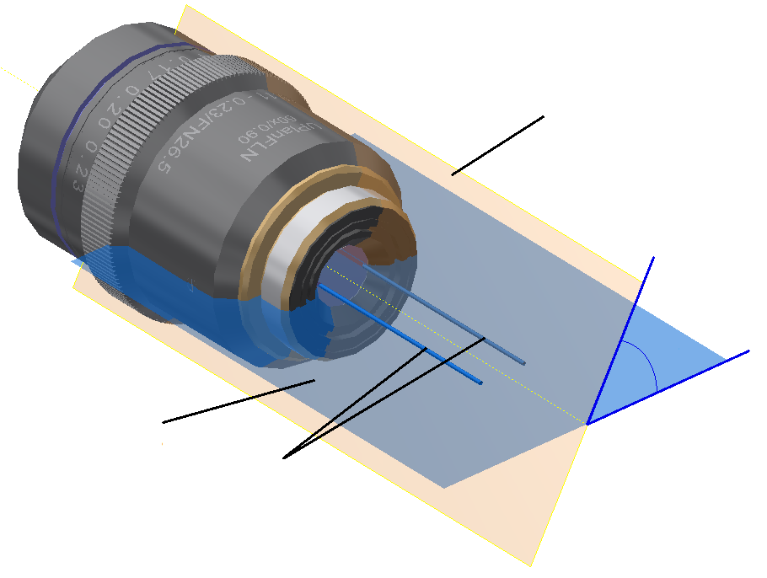
Plane at ϴ=60°
60°
Meridional
plane (ϴ=0°)
Lasers polarised
at ϴ=90°

